Slide 1
Small Area Variations in Life Expectancy
Michael Wolfson
Co-Authors: Derek Chapman, Jong Hyung Lee, and Steven Woolf (Virginia Commonwealth University), Vid Bijelic (University of Ottawa)
Financial Support: Anthony Iton, The California Endowment
(search: “statcan.gc.ca health reports wolfson”)

Slide 2
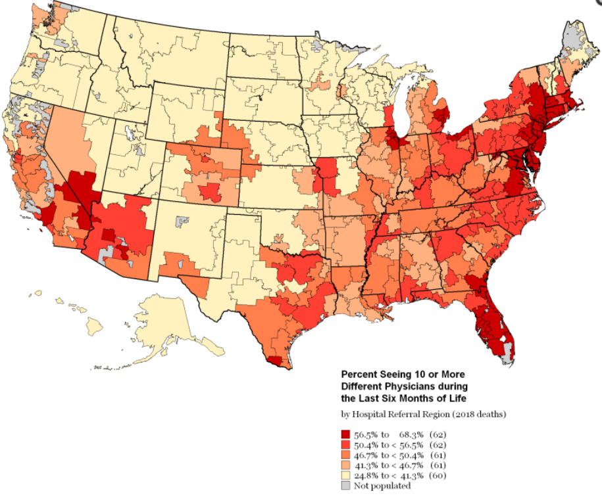
Small Area Variations are Ubiquitous, Have Been Observed for Decades, But Remain Generally Unexplained
Dartmouth Health Atlas pioneered by Dr. Jack Wennberg in 1996
this image: 10 or more MD encounters during last 6 months of life by hospital referral region, 2019 – why; wasteful?
these atlas analyses enabled by massive US medicare electronic health record database
Notes:
https://www.ncbi.nlm.nih.gov/books/NBK584990/figure/map-4/?report=objectonly

Slide 3
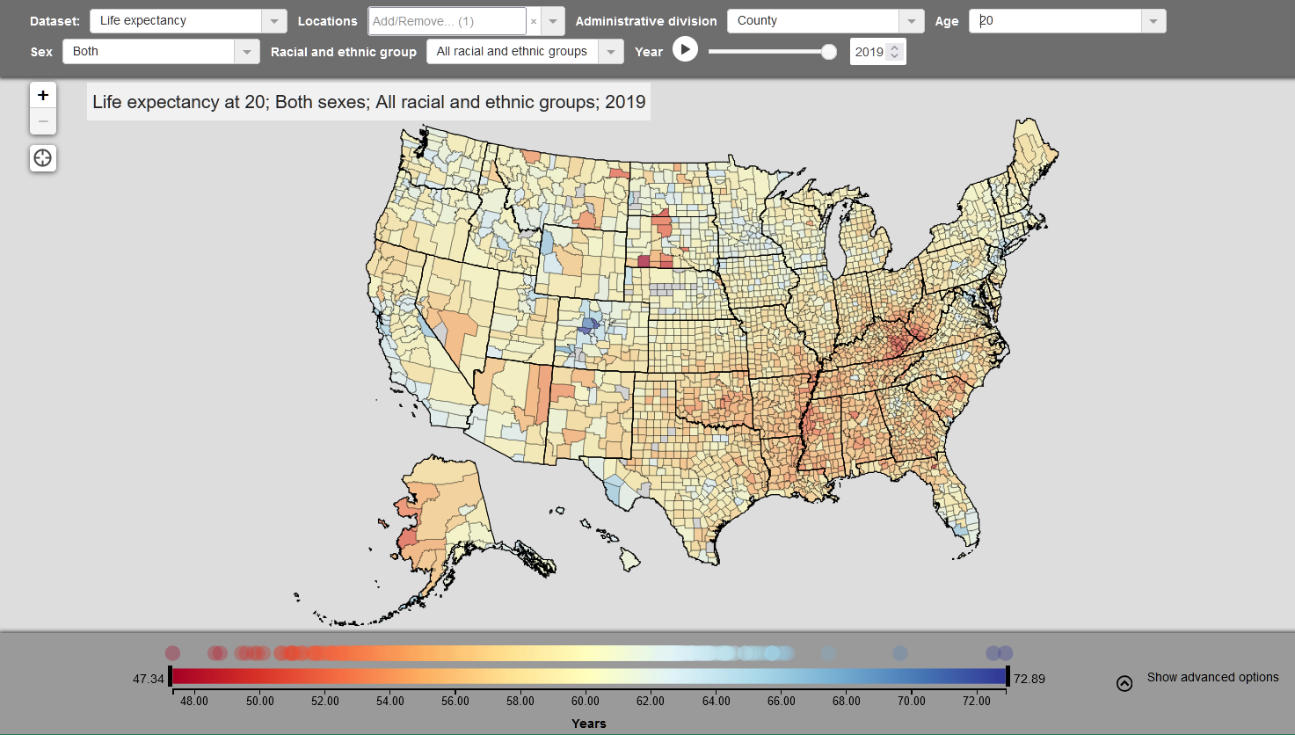
IHME US counties
More Recently, Small Area Variations in Mortality and Life Expectancy (LE)
LE at age 20, Counties, 2019, Institute for Health Metrics and Evaluation
Notes:
https://vizhub.healthdata.org/subnational/usa

Slide 4
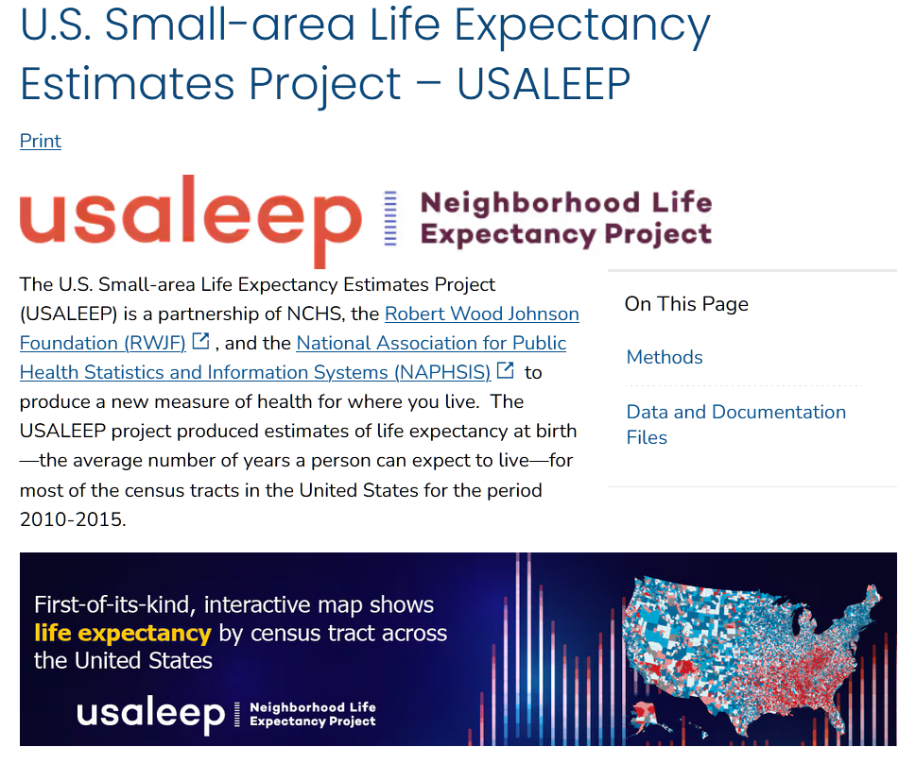
New Data in the US – by Census Tract
Notes:
https://www.cdc.gov/nchs/nvss/usaleep/usaleep.html#life-expectancy

Slide 5
Motivation and Hypothesis
Originated with Tony Iton wanting to place US health inequalities in an international context
Canada, as a comparator, has importantly different social and health policies compared to the US, so that it will be informative to explore their potential effects on (actually correlations with) small area variations in LE
  Main hypothesis: Canada will be seen to have less extreme variations
On the other hand, Canada is similar enough to the US in terms of language, culture etc. (e.g. unlike Sweden) so that any comparative findings will be salient for US policy makers
US already had not only county, but also census tract (CT) data on LEs
While comparable Canadian LE estimates had never been done before, all the data are available to construct highly comparable small area variation LE estimates at the CT level

Slide 6
Question: How do small area variations in LE at the census tract (CT) level compare within and across US and Canada’s largest cities
Method: estimate LEs at CT level in Canada, comparably to US
use death counts from 2006 to 2016; population counts from 2011 census, resulting in LEs centred on 2011
use LEs at age 20 (not at birth – questions re comparability of infant mortality, treatment of stillbirths, interest in roles of chronic disease)
assume geographic (inter-CT) mobility is not important
focus on subset of CTs that support “robust” estimates of LEs using abridged life tables (including standard error of LE < 1.5 years)
tabulate and graph variations in CT LEs within and across cities
explore extent to which variations in CT LEs are associated with CT-level SES = socio-economic status variables

Slide 7
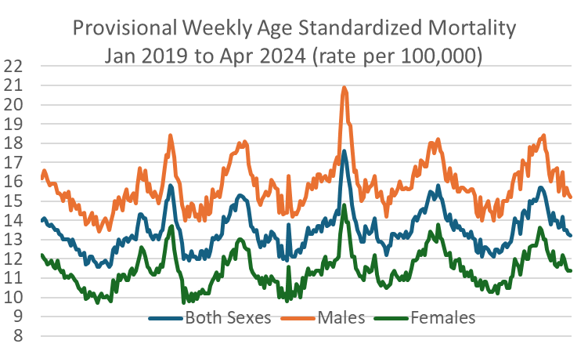
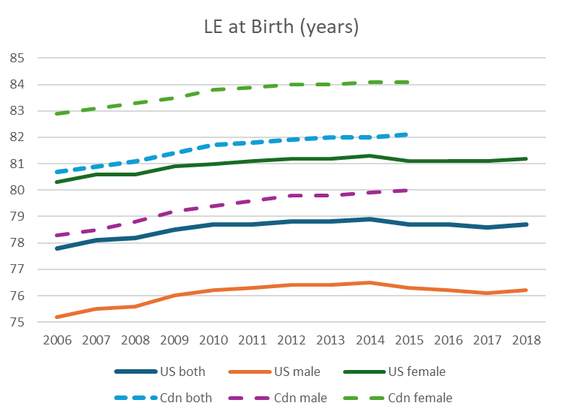
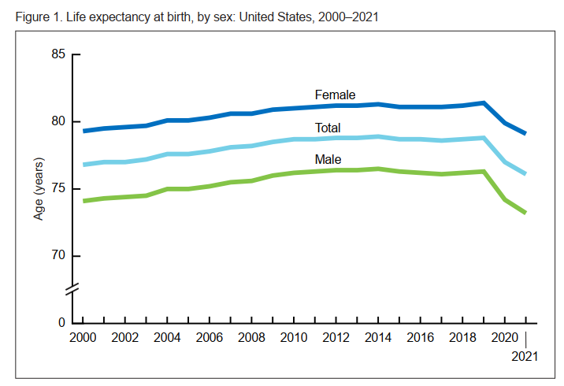
Context: LE Levels and Trends in Canada and US
Canada, unlike the US, has not experienced recently declining LE
mortality data, unfortunately are not timely
Canada
Canada
U.S.
U.S.
Notes:
US Vital Statistics Surveillance Report No 23 Aug 2022 – Rapid Release
Stat Can Table: 13-10-0389-01 and Table: 13-10-0879-01

Slide 8
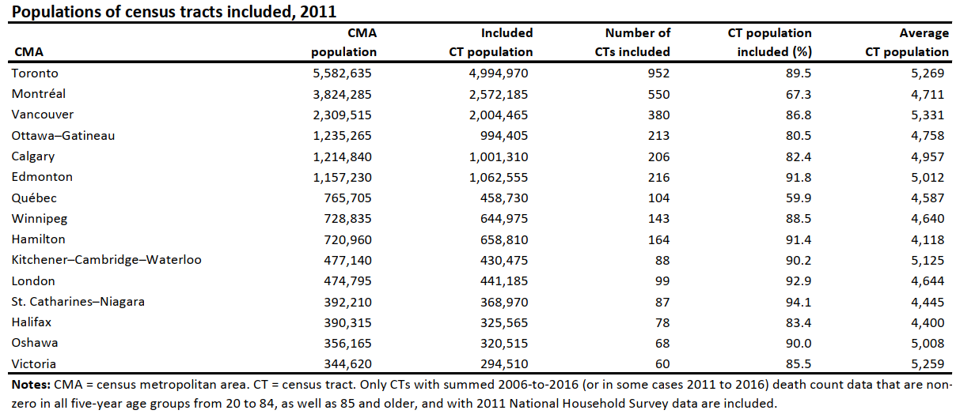
CMA and CT Populations
n.b. not clear why Montreal and Quebec City have such low CT population coverage

Slide 9
Distributions of “Robust” CT LEs at age 20, Canada 15 and US 9 Largest Cities
~ 10 year ranges in LE for middle 90% of CTs in each CMA
but (surprisingly?) Canadian ranges a bit higher than for US cities
again, not clear why Montreal and Quebec City have the highest ranges of LE across their constituent CTs
Notes:
from: Table S2 to S3f.xlsx

Slide 10
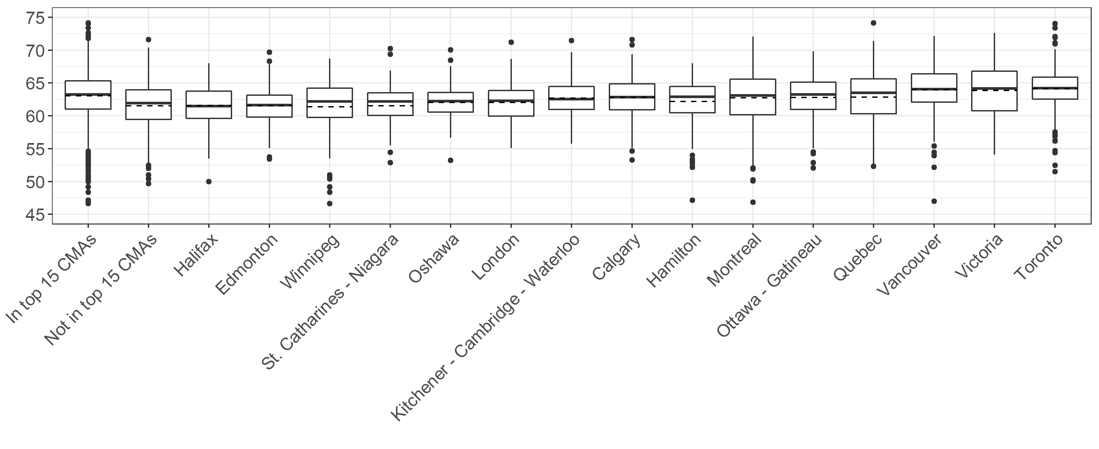
Distributions of Life Expectancies (LEs) at Age 20
ordered by median LE

Slide 11
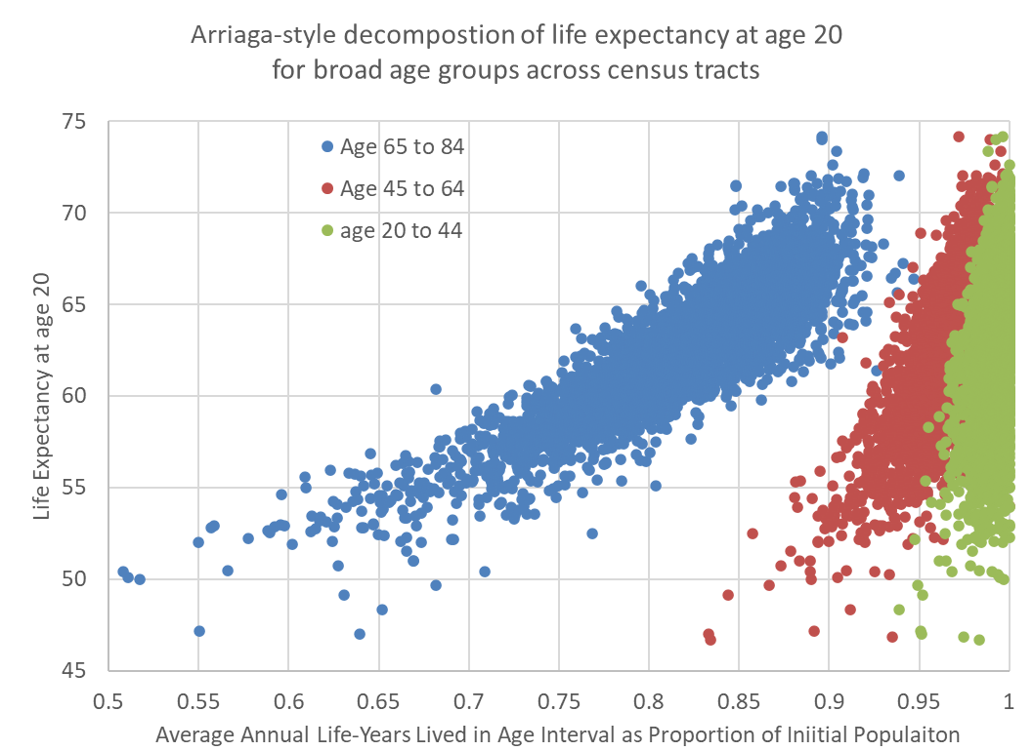
(Arriaga)
n.b. most mortality is at higher ages
thus, variations in LEs across CTs dominated by later age deaths
this Arriaga-style decomposition shows there are notable variations in deaths across the CTs studied at all ages considered
though to a smaller extent at younger ages

Slide 12
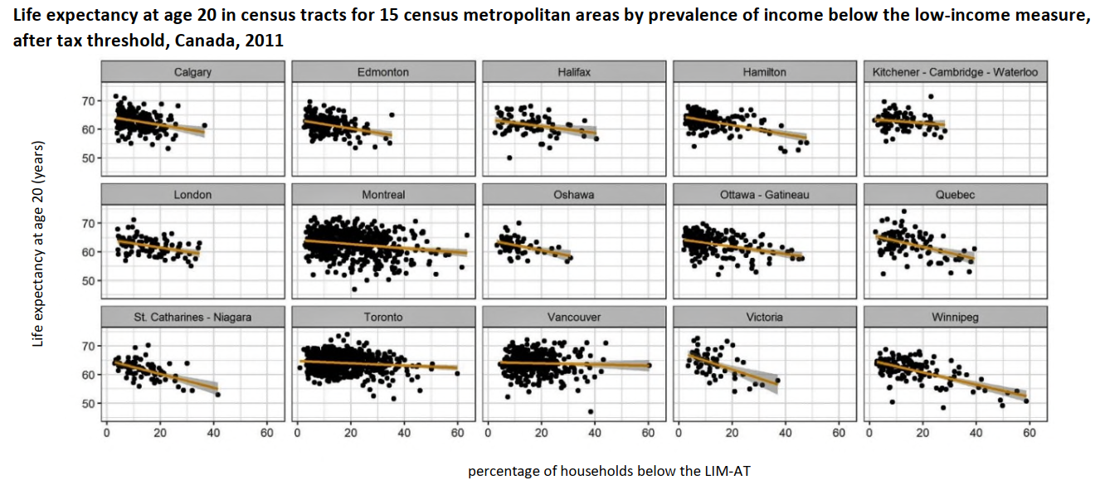
Life Expectancy by Low Income (%) Across CTs in 15 Largest CMAs

Slide 13
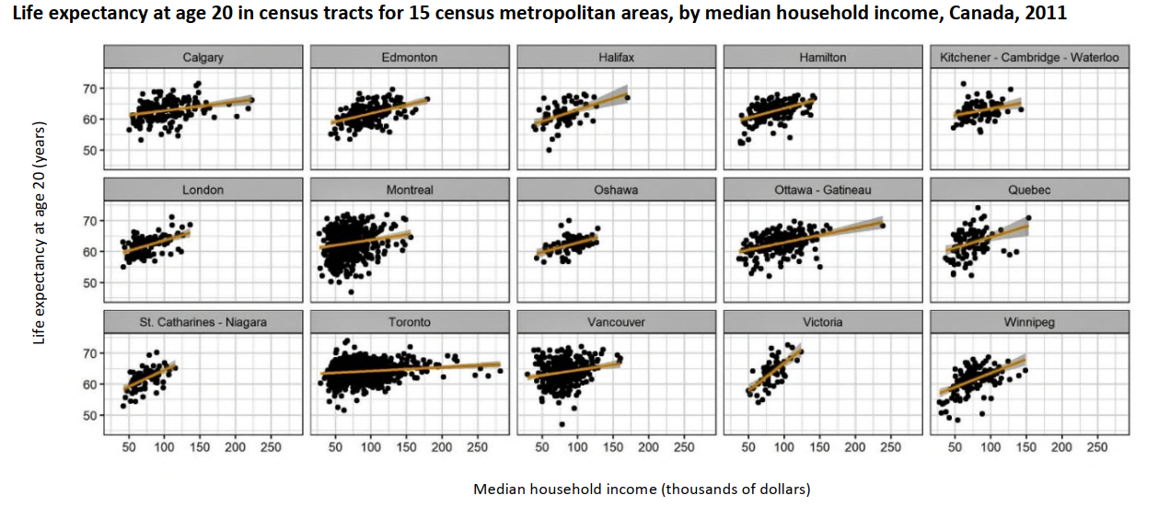
Life Expectancy by Median Family Income ($000s) Across CTs in 15 Largest Cities

Slide 14
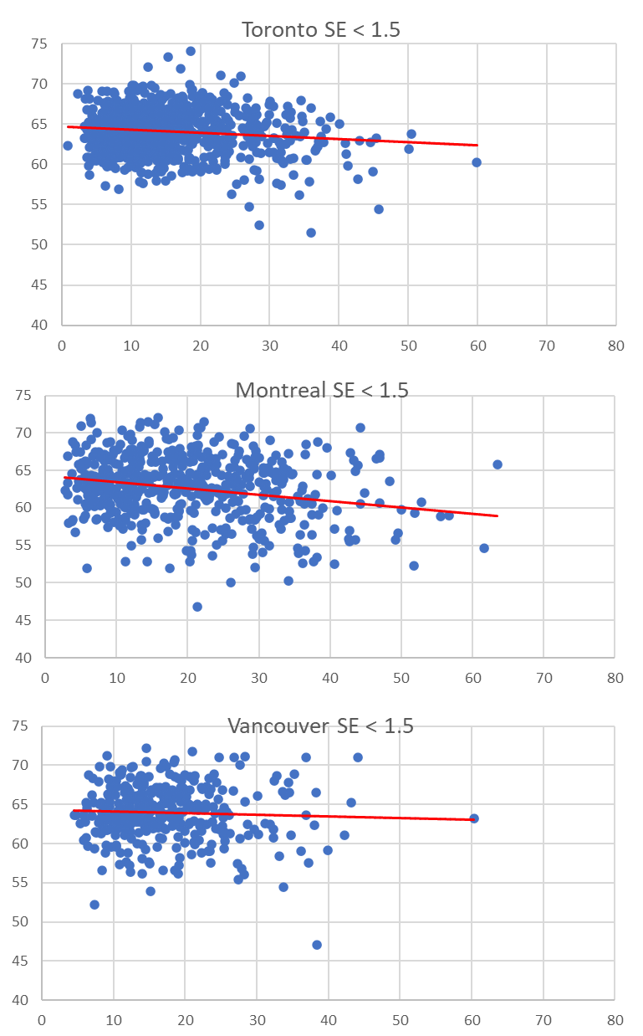
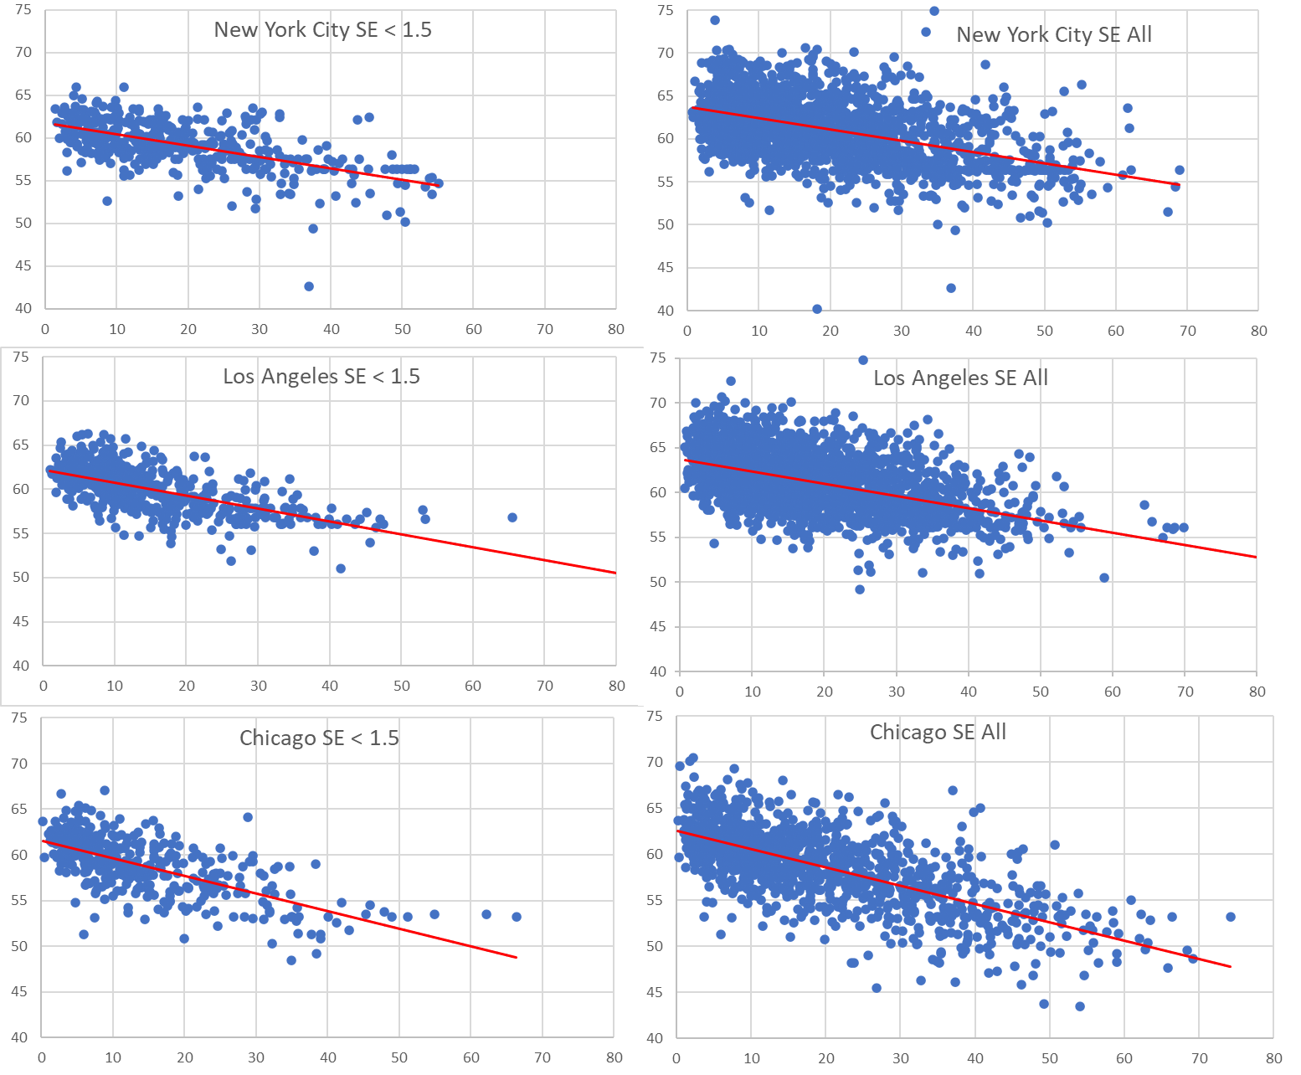
Canada – US, 3 largest cities, two versions for US cities
Notes:
US LE 20 regrns e.xlsx and CMA regressions incl All e.xlsx

Slide 15
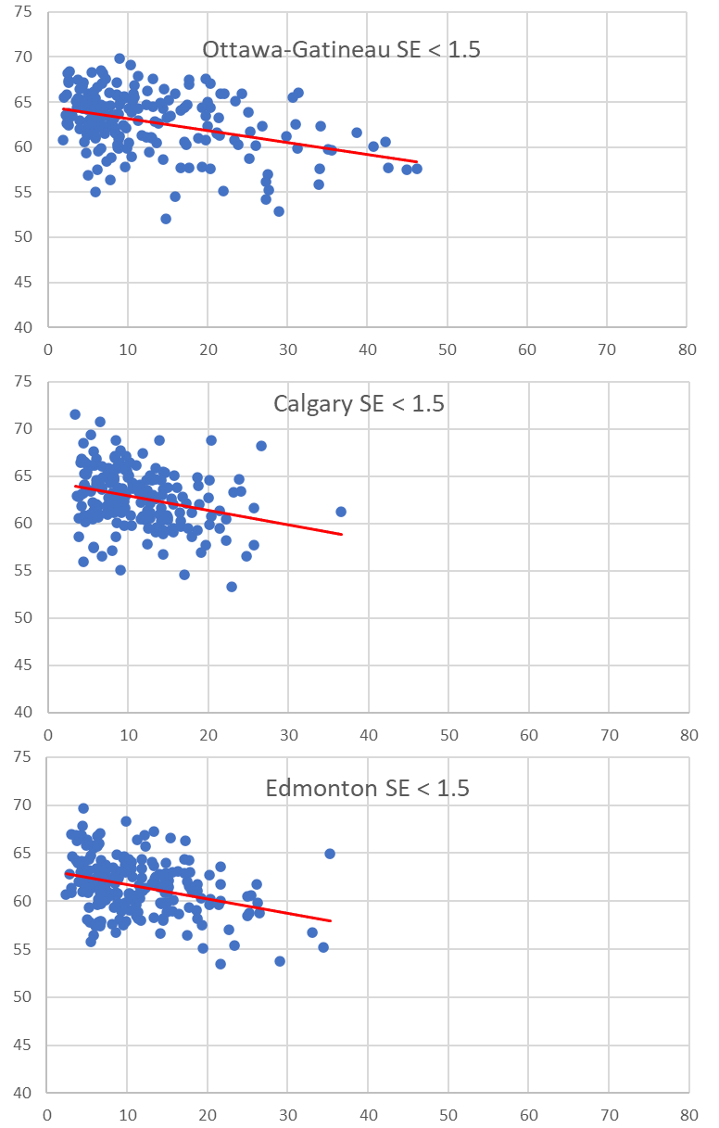
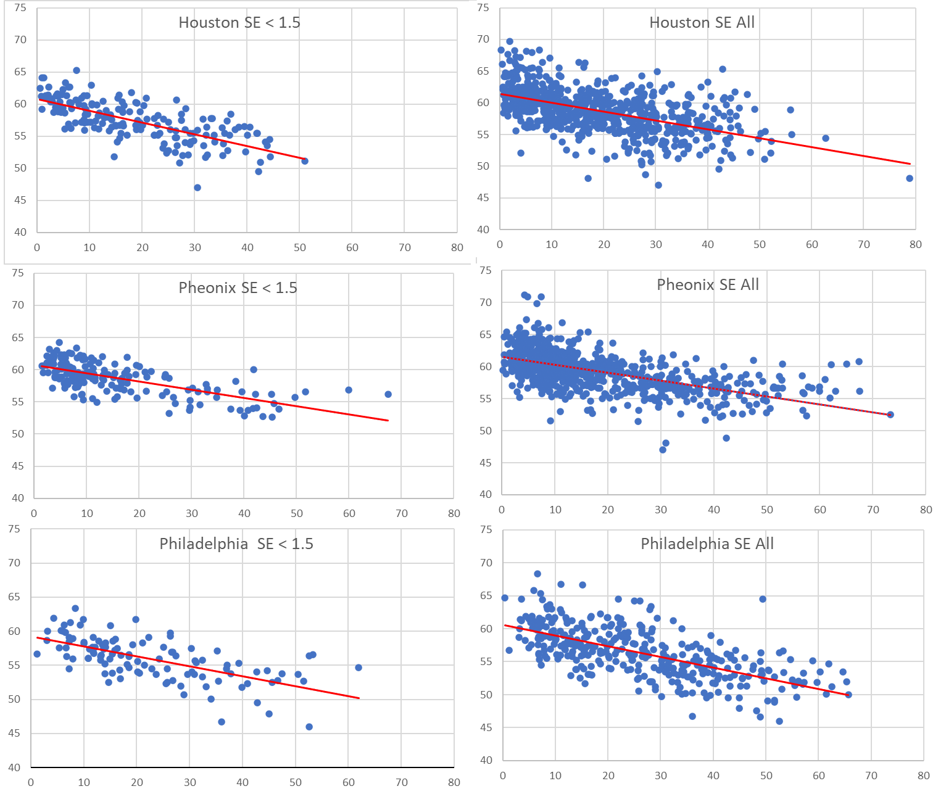
Canada – US, next 3 largest cities, two versions for US cities
Notes:
US LE 20 regrns e.xlsx and CMA regressions incl All e.xlsx

Slide 16
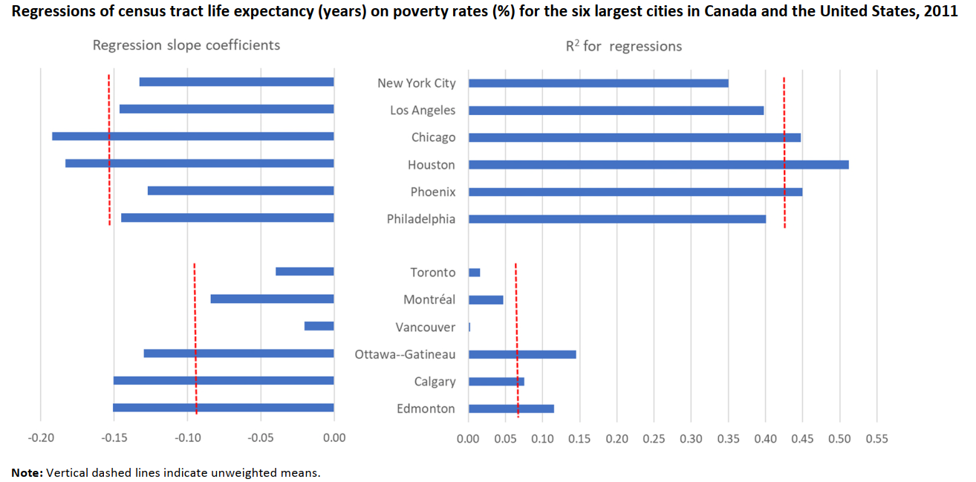
(regressions Canada – US, 6 largest cities)
as evident in the previous two slides, general patterns for US cities are the same when all CTs and not just those with tighter standard errors are considered
US cities have steeper slopes for LE in relation to CT poverty rates, and their CTs are more tightly clustered (higher R²) around their regression lines

Slide 17
Possible Reasons for Canada – US Differences
local government fragmentation: wealthier neighbourhoods in the US are better able to “opt out” of sharing local public goods = “opportunity hoarding”
compare waves of municipal and school board amalgamations in Canada
US has significantly higher social stratification than Canada
  half the rate of inter-generational income mobility
  stronger transmission of educational inequality
chronic stress – higher in the US?

Slide 18
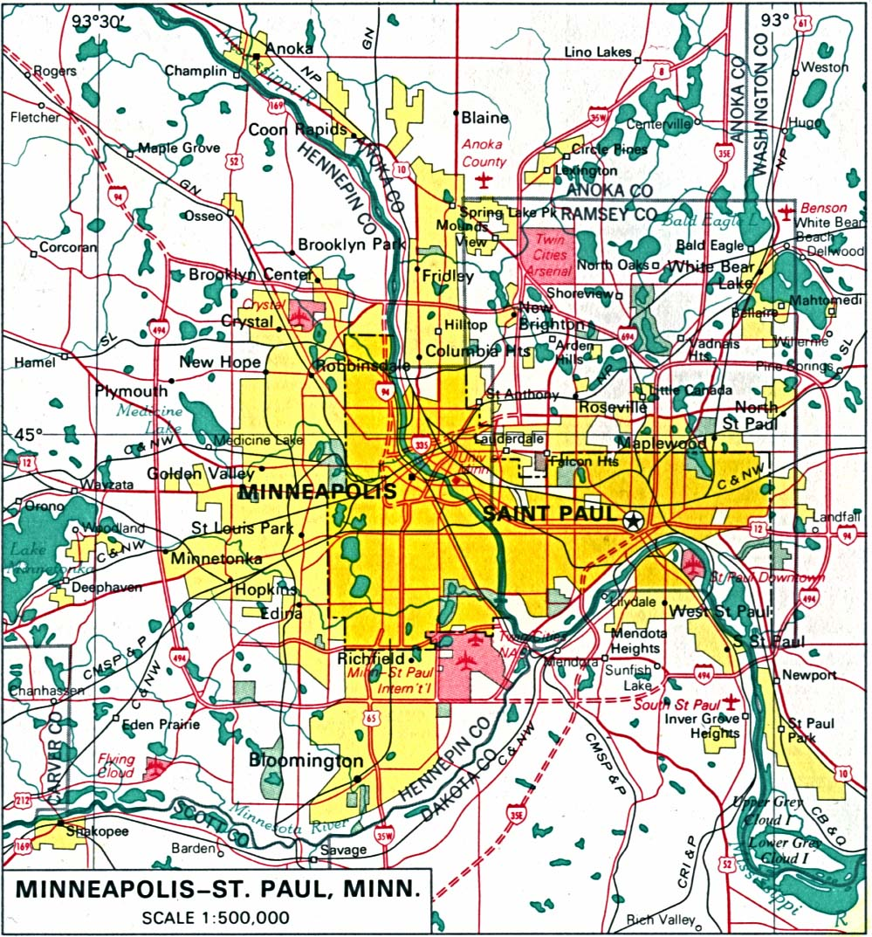
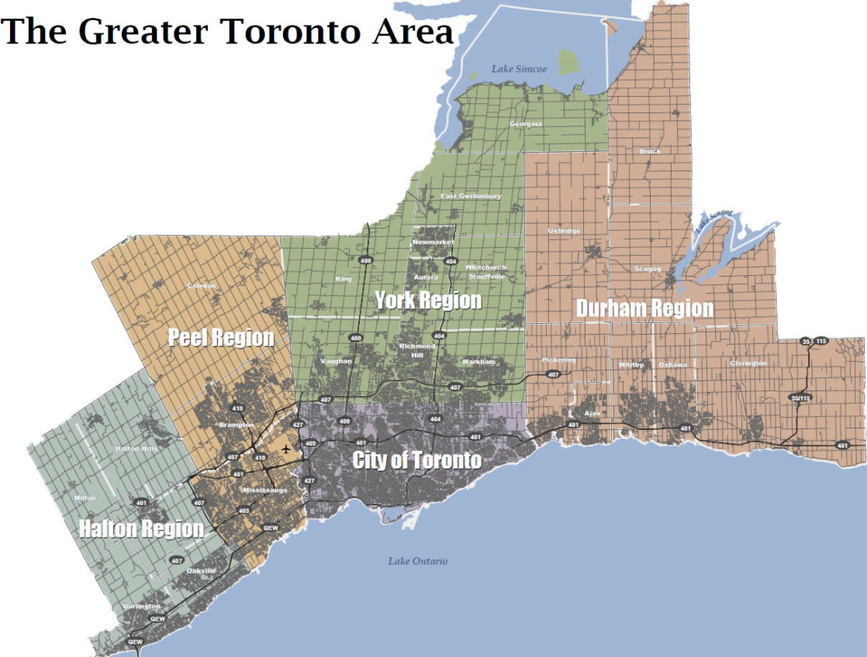
City Structure: e.g. Minneapolis and Toronto
200+ versus ~15 elected governments (municipal, school boards, etc.); comparable data lacking
Notes:
RFB notes:
On the subject of nbhds, this slide is to illustrate the major differences in the municipal governance structures in the US versus Canada. Many major US cities have hundreds of elected governments whereas Canadian cities have far fewer, following repeated amalgamations over the years. One of our key conjectures is that this important aspect of the differing social environments between the two countries plays an important role in accounting for the patterns observed in the Ross et al study. (QQQ we lack the data for the following; should be deleted: Certainly, it has been observed that there are higher levels of sorting and economic/racial segregation in the US versus Canada.) As a result, we have given the U cities more nbhds than the C cities and made it easier for sims to move nbhds and sort themselves based on their income in the U cities.
(delete: While we did integrate this dynamic into the model, since there are not very good comparable data between the two countries, so we did not strive to achieve any particular level of segregation between the C and U scenarios, other than what emerged naturally. )
------
TIME: 45 SEC (13:00)
--------
MCW notes:
http://www.yraeh.ca/~yraeh/sites/default/files/userfiles/map_gta.jpg
http://img110.imageshack.us/img110/7076/torontodensity3dw1.gif
http://www.mapsget.com/maps/city-maps/north-america/us/minnesota/minneapolis.jpg
mention govts, and also racial segregation

Slide 19
Share of Private School Enrolment and Median Income Across 772 School Districts in California, 2012
compare: 38 school districts in Ontario (2x school boards)
equivalent to ~ 100 school districts across Canada
compare 772 districts in CA (similar population)
hence Canada has ~1/8th as many school districts per capita
Notes:
https://en.wikipedia.org/wiki/List_of_school_districts_in_Ontario

Slide 20
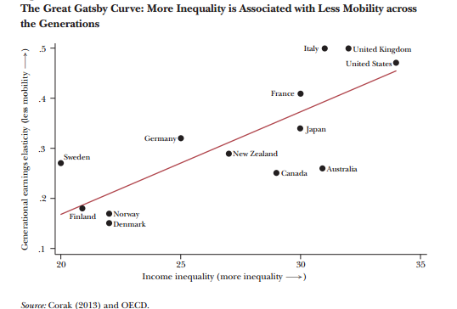
Parental Influence – Father-Son Income Elasticities vs Gini
Canada has lower income inequality than the U.S. (horizontal axis)
and “twice” the inter-generational mobility (vertical axis)
Miles Corak, Journal of Economic Perspectives, Volume 27, No. 3, 2013

Slide 21
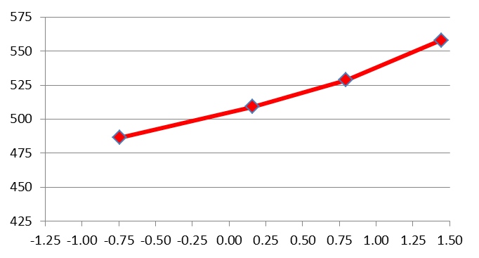
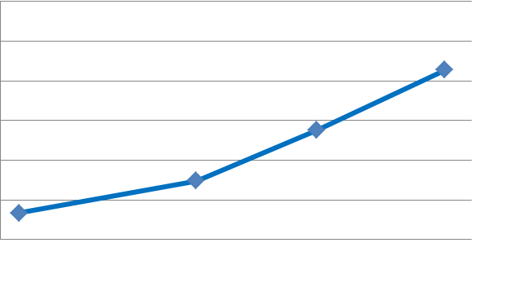
Parental Influence – PISA Math Scores by Parental Socio-Economic Status (SES) Quartiles
Canadian math scores higher overall than U.S
more inequality in parental SES (horizontal axis)
correlation between parental SES and PISA math score: 50% higher in the U.S.
hence wider dispersion in US scores (vertical axis)
Canada
U.S.
OECD, PISA 2012 Database, Table II.2.6

Slide 22

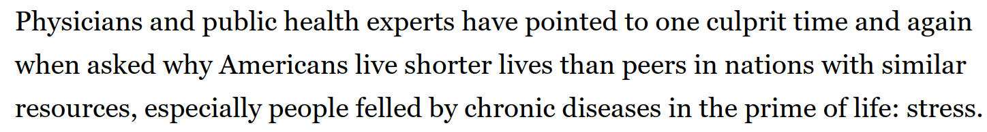
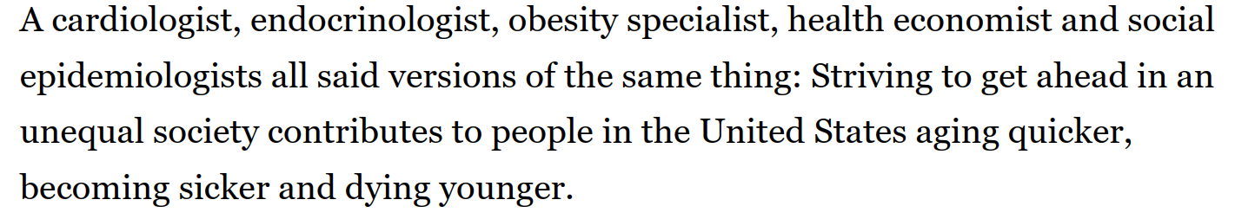
Chronic Stress
Washington Post, October 17, 2023
Notes:
https://www.washingtonpost.com/health/interactive/2023/stress-chronic-illness-aging/?itid=sr_1_35e5105e-b79e-45f9-9d0a-084ae14c9fbb

Slide 23
Conclusions and Discussion (so far)
first ever high quality LE estimates at CT level for Canada
designed to be highly comparable to corresponding US LE estimates
for all Canadian cities, varying correlations between LE and SES
  including 2+ cities within the same province(!)
  hence widely ignored municipal factors are in fact important
LE-SES correlations systematically stronger in US versus Canada
yet both have similarly wide ranges of LE across CTs within each city
still unexplained
  what city level factors could account for variations within provinces?
  why such wide ranges in LE across CTs within larger cities even though
    major SES factors (poverty, median incomes) have been considered
    correlations with SES are so much stronger in the US?

Slide 24
And Now for Something New...
Extending the Analysis of Small Area Variations in Life Expectancy to Federal Electoral Districts (FEDs) as well as Correlations With SES and Voting Patterns
PRELIMINARY – PLEASE DO NOT QUOTE OR CIRCULATE
(M.C. Wolfson, Oct 2024, self-funded)

Slide 25
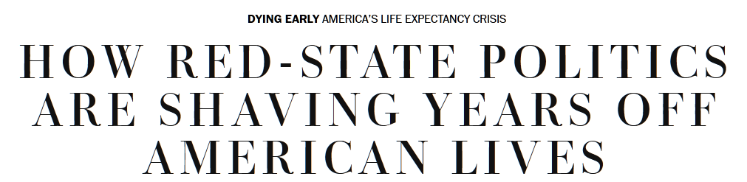
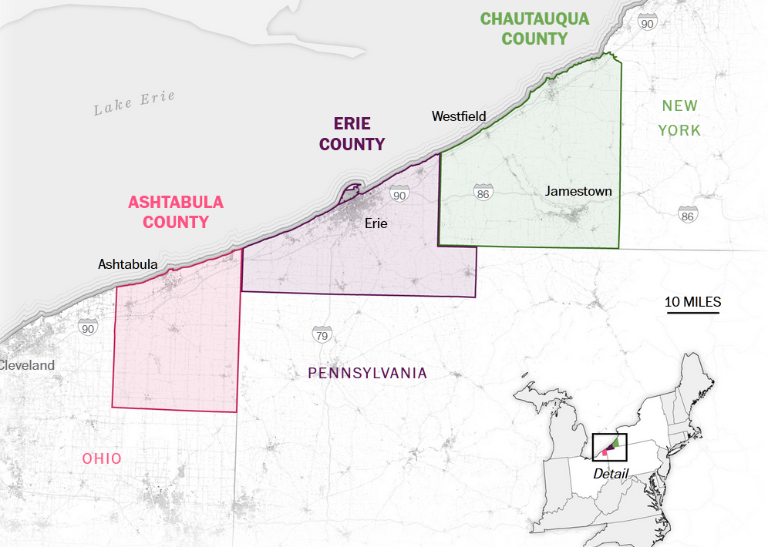
Context from US
“natural experiment”: three otherwise very similar counties but in different states
differentiating factors cited
  political party in control
  tobacco taxes / smoking-related mortality
  highway safety laws
  public health spending
  Medicaid and social safety net funding
  not quality of local hospitals
recall chronic stress
Washington Post, October 3, 2023
Notes:
https://www.washingtonpost.com/health/interactive/2023/republican-politics-south-midwest-life-expectancy/?itid=ap_laurenweber

Slide 26
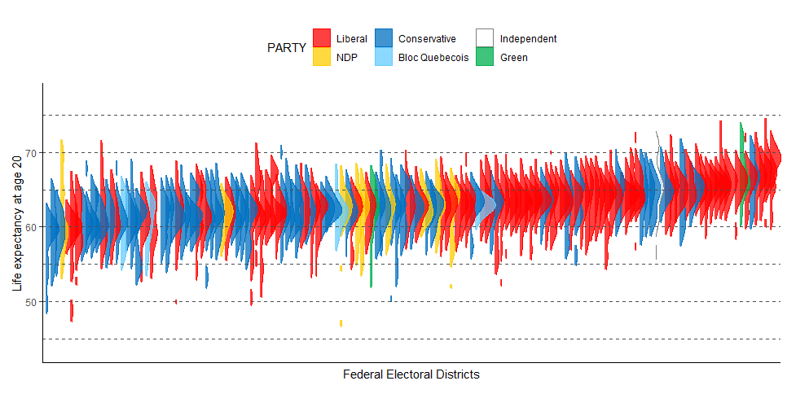
LEs in Liberal Ridings Generally Higher than in Conservative Ridings
Correlation ≠ Causation
PRELIMINARY – PLEASE DO NOT QUOTE OR CIRCULATE
Distributions of LE within each FED, Sorted by Median LE

Slide 27
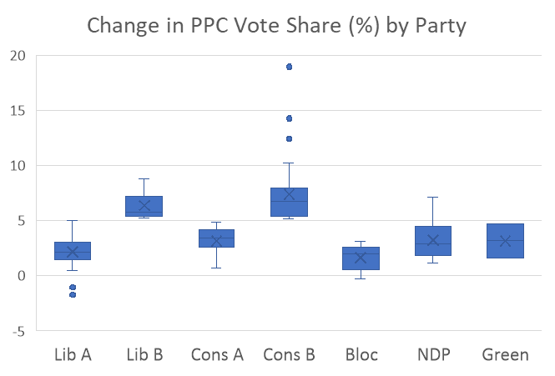
Preliminary Statistical Analysis
PRELIMINARY – PLEASE DO NOT QUOTE OR CIRCULATE
re-use same CT level LE and SES variables for 2011
in addition to riding’s winning political parties, note that PPC (Peoples Party of Canada) increased its vote share 2019 to 2021
  PPC did not win any seats
  but still may be informative to break down Conservative and Liberal ridings according to whether PPC vote share increased by > 5 percentage points (A) or not (B)

Slide 28
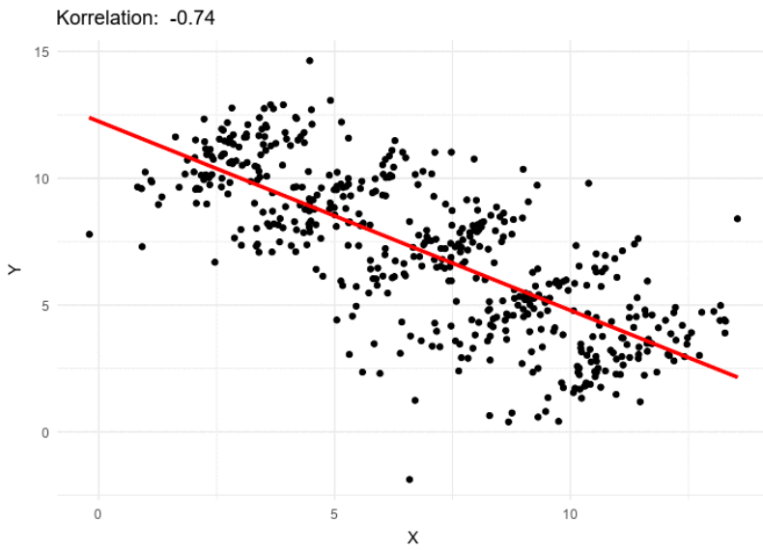
Simpson’s Paradox
caveat re multi-level data
illustration where by analogy:
  dots are CTs
  X = poverty rate
  Y = life expectancy
here, a simple one level linear regression
Notes:
https://en.wikipedia.org/wiki/File:Simpsons_paradox_-_animation.gif#/media/File:Simpsons_paradox_-_animation.gif

Slide 29
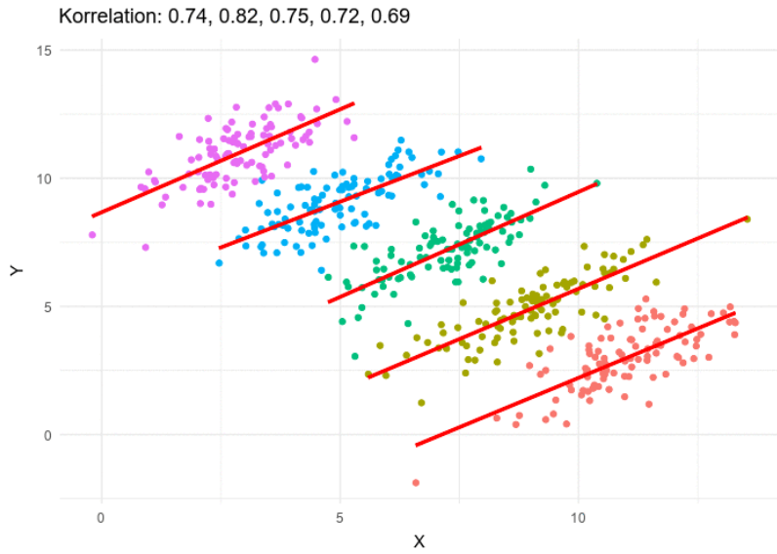
Simpson’s Paradox
same X and Y
but now notice role of including FED level by analogy
two-level regression reveals an entirely different pattern
Notes:
https://en.wikipedia.org/wiki/File:Simpsons_paradox_-_animation.gif#/media/File:Simpsons_paradox_-_animation.gif

Slide 30
Federal Electoral Districts (FEDs) by Percentages of Population Data Available
PRELIMINARY – PLEASE DO NOT QUOTE OR CIRCULATE
based on populations of 7,536 CTs within 296 FEDs for each region
  n.b. not all 338 of 2013 FEDs have CTs
used cut point – only FEDs with at least 75% of their populations in constituent CTs included in statistical analysis
result: 212 FEDs with > 75%
caveat: Quebec has many FEDs with < 75% population coverage
hence many Bloc-won ridings not covered
Notes:
from ““pct pop box plot by region.tiff”; CT and FED counts from from “FEDs With Percent Population Available for Analysis w 296 FEDs zb.xlsx”

Slide 31
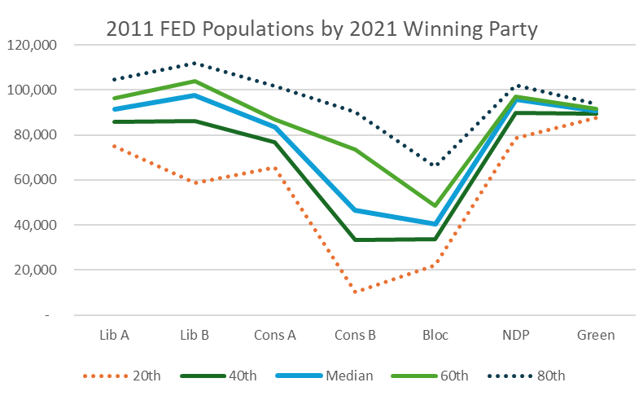
Distributions for 212 Federal Electoral Districts’ (FED) Population Sizes in 2011 by Winning Political Party in 2021
PRELIMINARY – PLEASE DO NOT QUOTE OR CIRCULATE
Lib and Cons ridings broken down by A or B
“A” = riding where PPC vote share increased by < 5%
“B” = riding where PPC vote share increased by > 5%
Cons B and Bloc have more of the smallest riding populations
n.b. many Bloc-won ridings not included
n.b. riding sizes do not accord with “one person, one vote”
Notes:
from “graph LEs by main party c.xlsx”

Slide 32
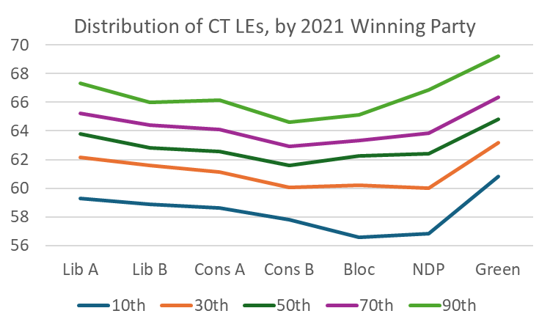
Overview of Main Party Associations with LE at Age 20
PRELIMINARY – PLEASE DO NOT QUOTE OR CIRCULATE
based on data for 3,439 CTs in 212 FEDs with adequate population data
general trend: more conservative associated with lower average LE
e.g. median LE in Cons B ridings ~2 years lower than in Lib A ridings
Notes:
from: “FED – JASP w CTs a.xlsx”

Slide 33
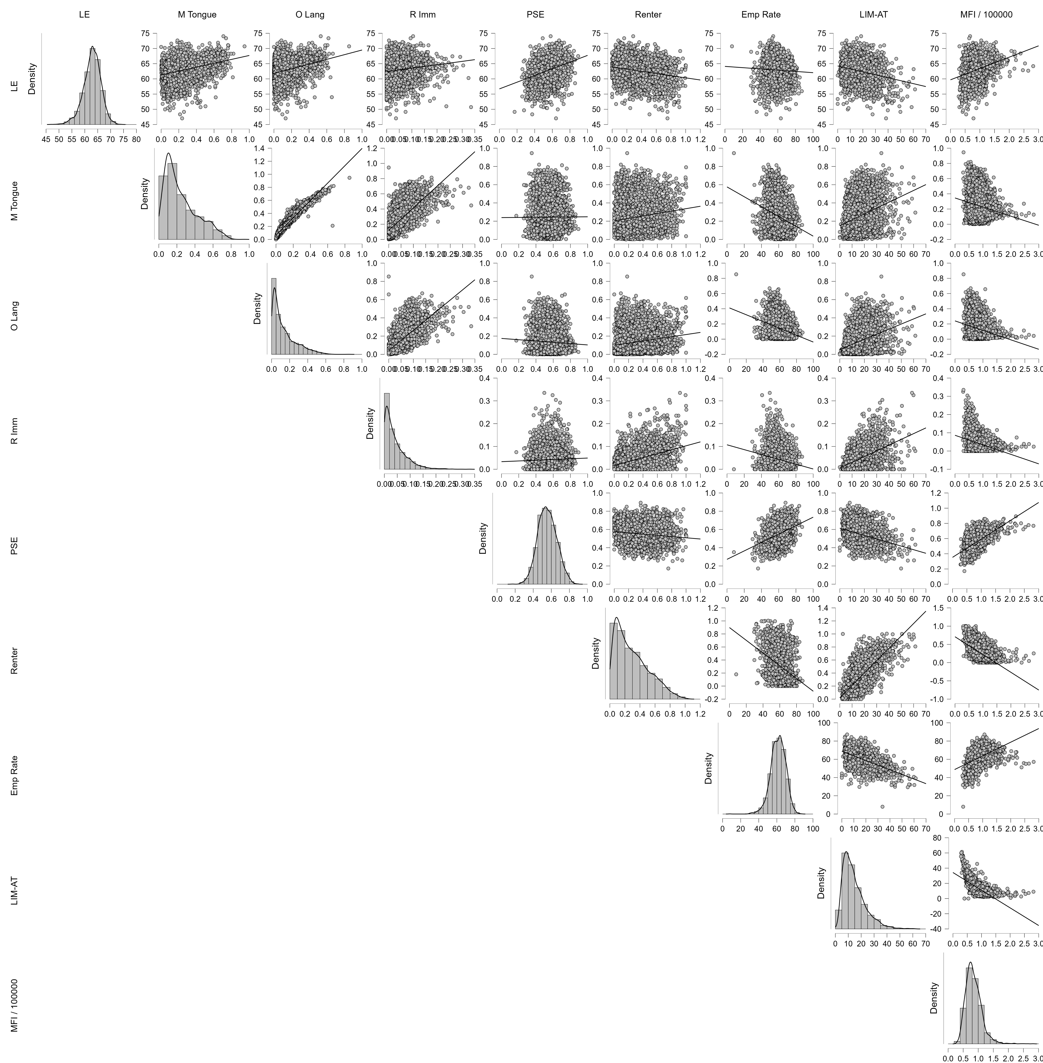
Correlation Matrix for CT Level Possible ”Explanatory” Covariates
PRELIMINARY – PLEASE DO NOT QUOTE OR CIRCULATE
top row shows several covariates are highly correlated with LE at CT level
exploratory factor analysis suggests two main factors
  allophone & recent immigration
  income & poverty
for linear regression, should avoid correlated independent variables
  e.g. both language variables highly correlated
  n.b. PSE also looks highly correlated with LE
  but specific choice is somewhat arbitrary
Notes:
from: “EFA etc results 3439 CTs c.xlsx”, “scatters” sheet

Slide 34
3 Single Level Linear Regressions for 212 FEDs: Average LE at Age 20 on 2021 Political Party
PRELIMINARY – PLEASE DO NOT QUOTE OR CIRCULATE
one percentage point increase in PPC vote share from 2019 to 2021 is very significantly associated with about one-quarter year decrease in LE (1st regression)
when winning parties are also included, coefficient on ∆ PPC Vote % is still significant but a bit smaller (3rd regression)
leaving aside ∆ PPC Vote %, Cons A ridings have about one year lower LE, while Cons B ridings have about 2 years lower LE compared to Lib A ridings (2nd regression)
Bloc and Green FEDs are not statistically significant (2nd and 3rd regressions)
NDP ridings are significantly associated with > one year lower LE (2nd and 3rd regressions)
Notes:
from: FEDs w LE & SES q.xlsx

Slide 35
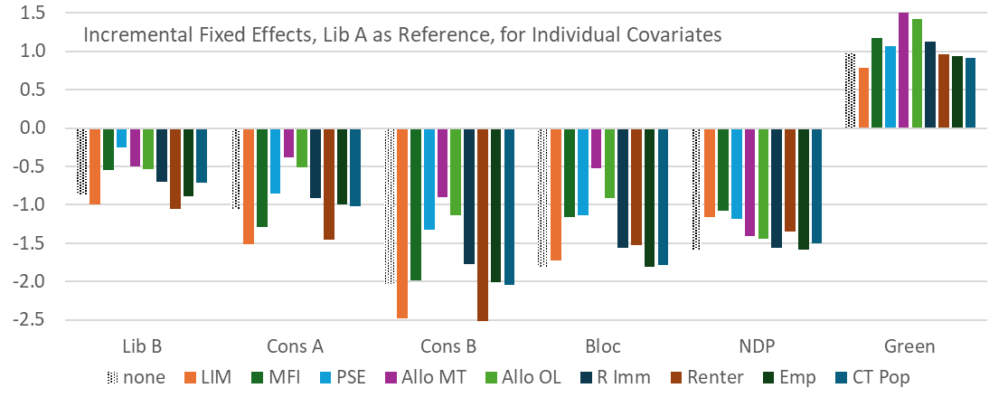
Linear Multi-Level Incremental Fixed Effects
PRELIMINARY – PLEASE DO NOT QUOTE OR CIRCULATE
dependent variable: LE at age 20 (3,439 CTs in 212 FEDs)
independent variable: one 2011 SES covariate at a time
plus 2021 elected party, with Lib A as reference
e.g. “Allo MT” (Allophone: mother tongue) reduces size of party coefficients on LE 20 the most (e.g. for Cons B from -2.0 to about -0.9 years: )
Notes:
from: “FEDs linear mixed models b.xlsx”

Slide 36
Provisional Concluding Comments
PRELIMINARY – PLEASE DO NOT QUOTE OR CIRCULATE
more conservative federal electoral districts were associated with lower 2011 life expectancy at age 20
these associations are reduced when analyzed statistically in combination with 2011 CT-level census socio-economic status covariates
i.e., when account is taken of factors associated with immigration, income (including poverty), education, and population density, a considerable portion of the relationship between political party election results and LE is “explained” (statistically, i.e. accounted for)
n.b. these LE differences are of similar magnitude to impact of all deaths due to cancer, but compare research efforts
ideally, data on further possible covariates should be studied, e.g. chronic stress markers, public health measures, political and other attitudes – but these data are generally unavailable,
Notes:
from: FEDs w LE & SES q.xlsx

